Slide 1
Crimson Clubs (Design)
Adam Gabriel, Travis Redfield, Taylor Meads,
Maclane May, Max Livingston

Slide 2
Problem Description
None existent quality club and intramural calendar and statistical tracking
Poor existing applications/solutions
Hard to use
Slow
Poor user experience
Intrusive Advertisements

Slide 3
Scope of System
Manage clubs and teams
Receive push notifications to your phone
View calendar of events

Slide 4
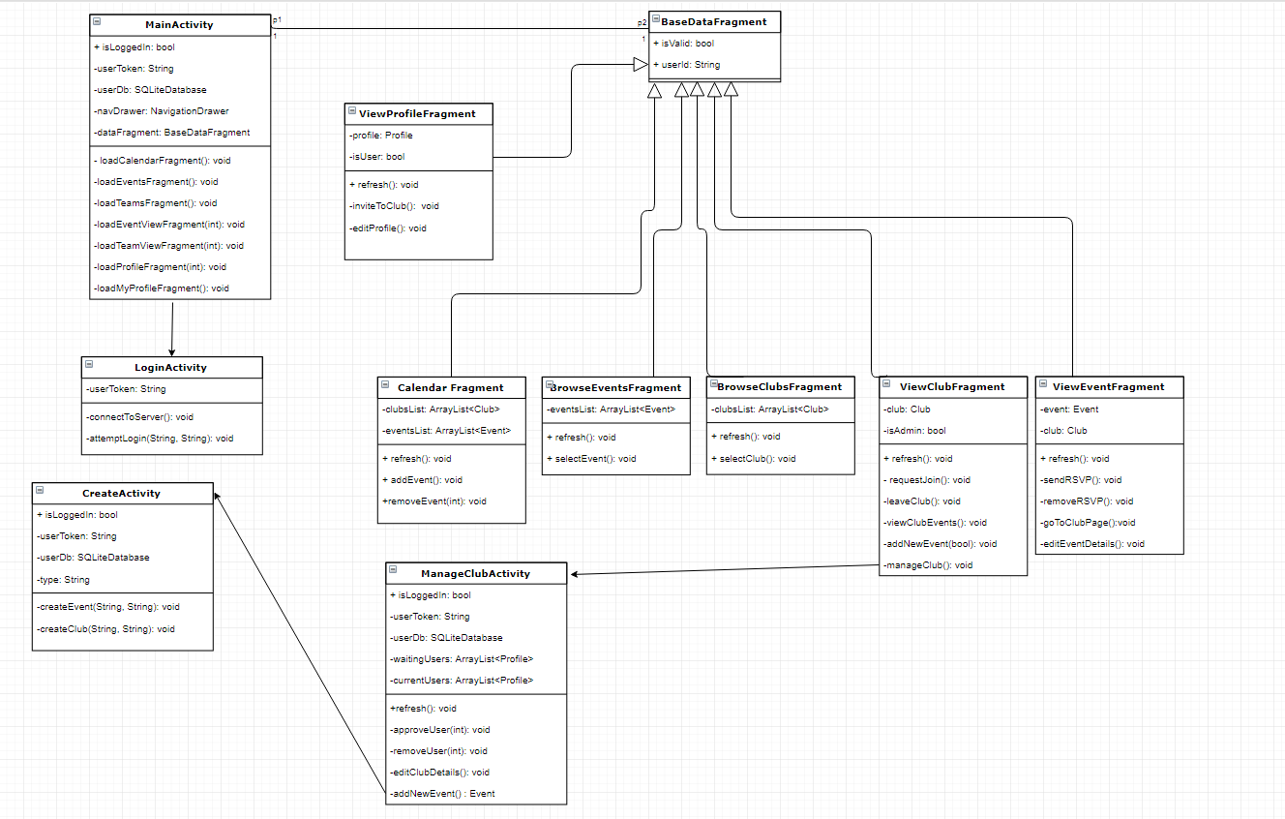
Class Diagram

Slide 5
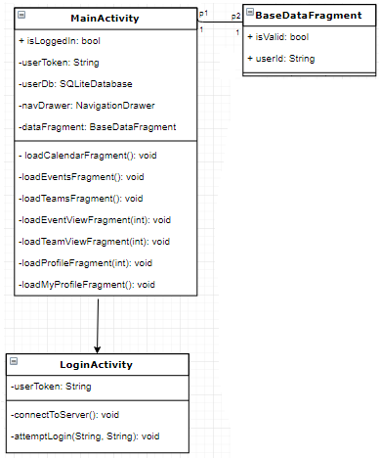
Class Diagram

Slide 6
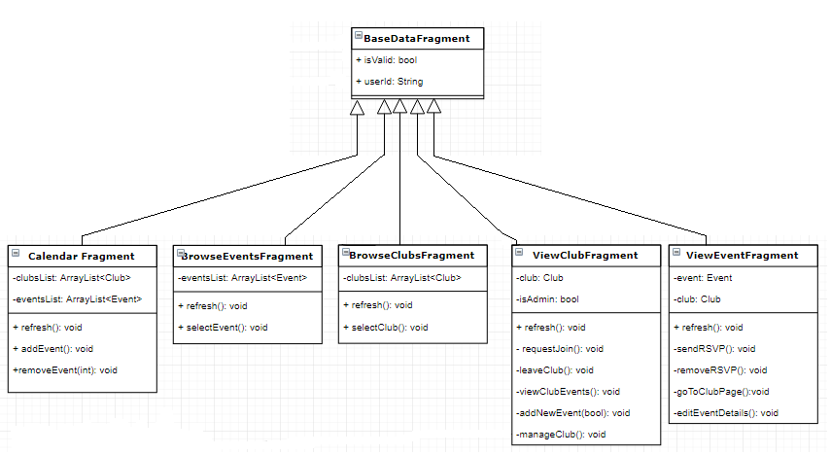
Class Diagram

Slide 7
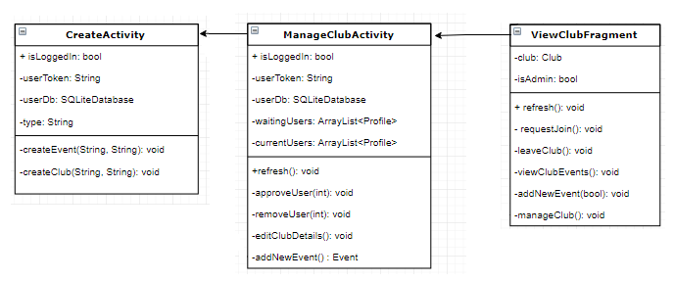
Class Diagram

Slide 8
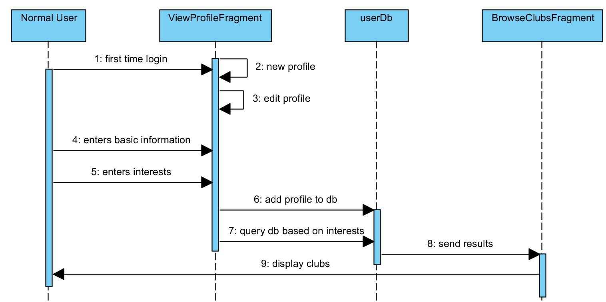
Create Profile

Slide 9
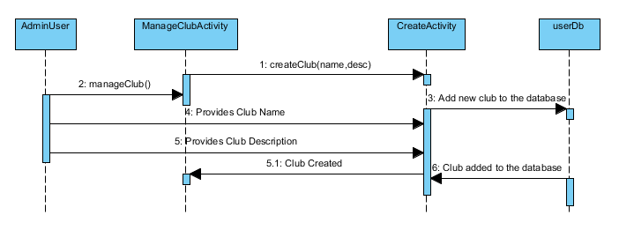
Create Club

Slide 10
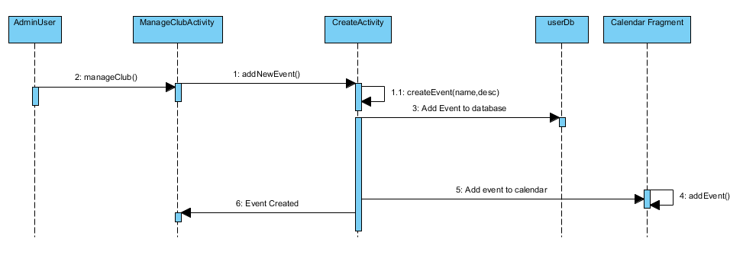
Create Event

Slide 11
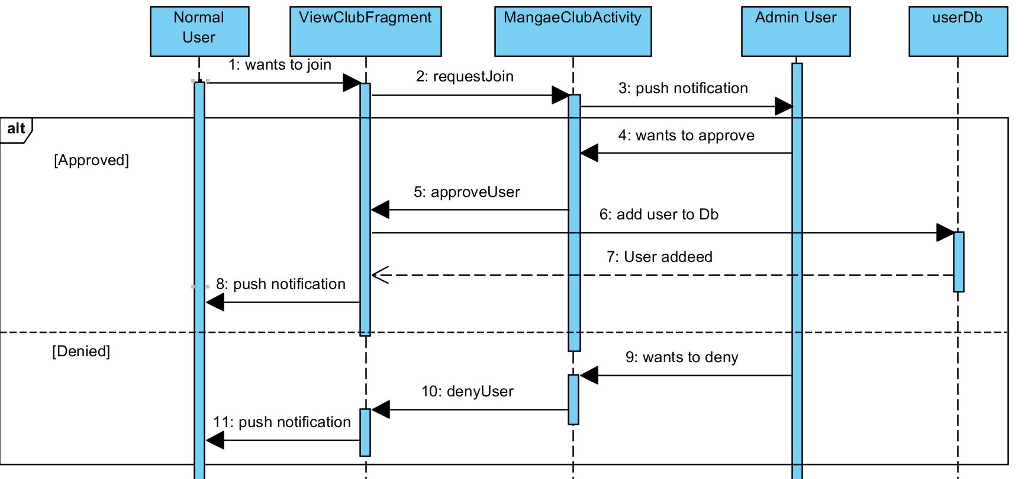
Join Club

Slide 12
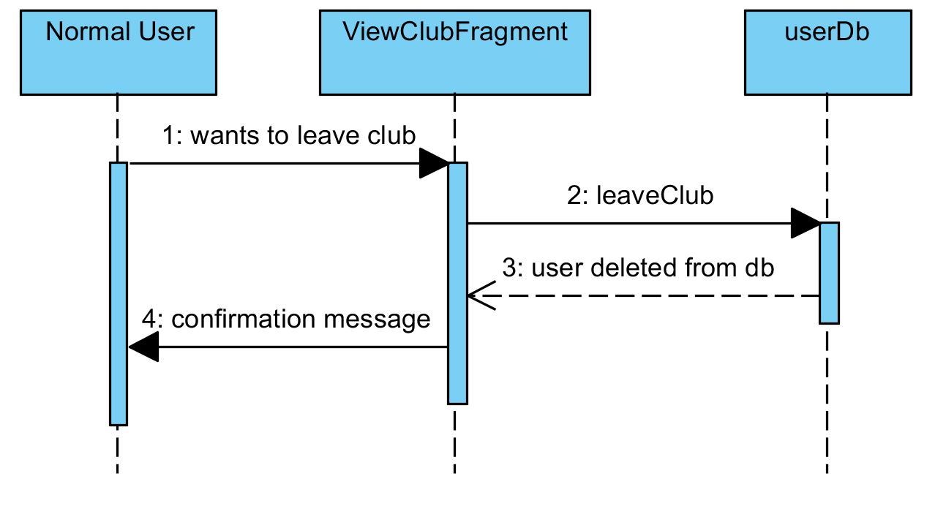
Leave Club

Slide 13
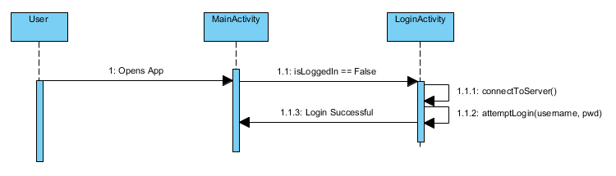
Login Activity

Slide 14
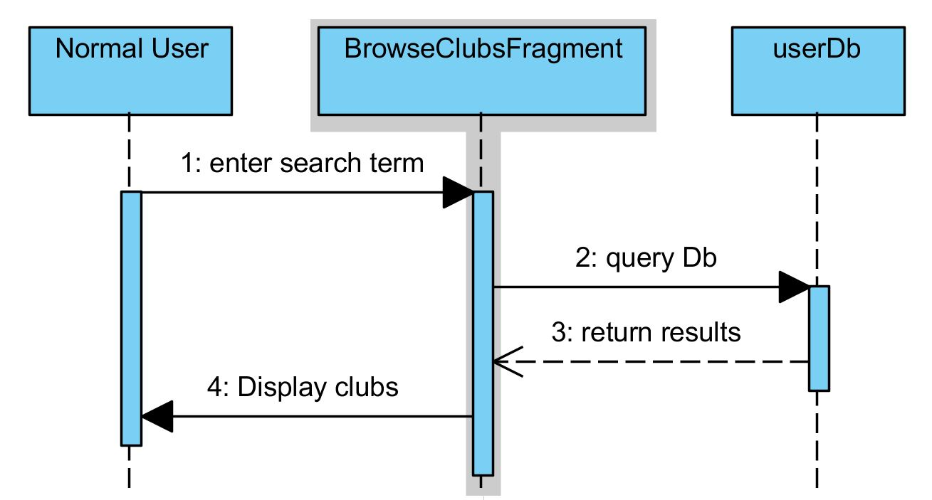
Search Clubs

Slide 15
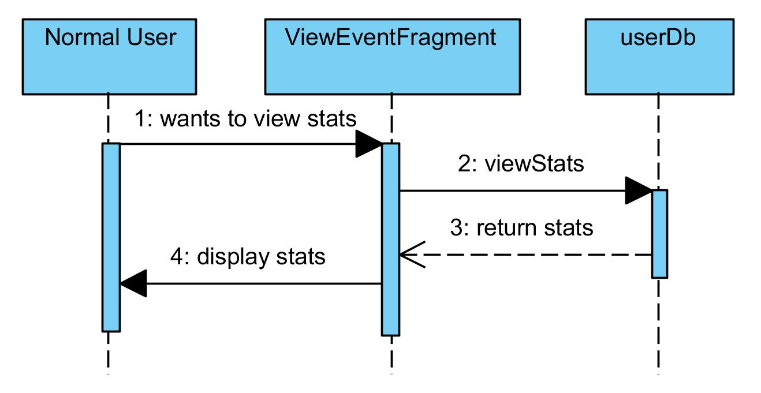
View Event Statistics

Slide 16
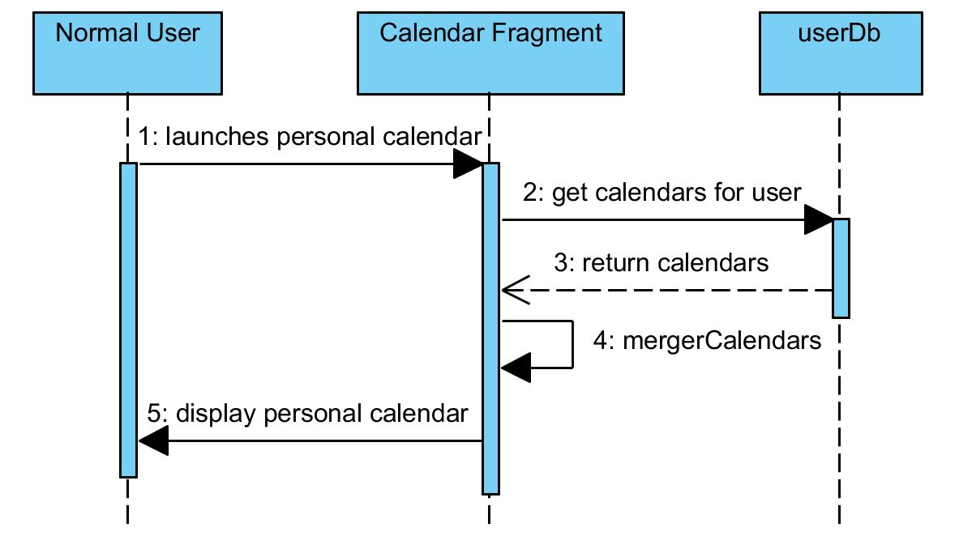
View Calendar

Slide 17
Project Changes
No major project changes
Shifting focus
Database (stored procedures)
Backend API (auth and web calls)
Front ends (app and site)
Demo

Slide 18
Summary
Good progress
Shift from design to implementation
No major blockers (yet)
Focus on demo

